Slide 1

Project Presentation on “Student Mentor Guidance System” Submitted in partial fulfillment for the award of Post Graduate Diploma in Advanced Computing (PG-DAC) from C-DAC, NETCOM (JAIPUR)
Guided By:
Miss.Prajakta
Presented by:
Name Of Students: 1) MAYUR DHAMANSE
2) NIKHIL DHUMAL
3)ROHAN GHODKAE
VVV 4)SOHAM PHAPLE
5)SOMNATH GHANWAT
PRN GGGGGG VVV

Slide 2
Introduction
The system mainly consists of SMGS Online system containing application server and web server. SMGS interacts with the database to get student and mentor information. Secondary information like courses and queries are stored in the database.
The “Student - Mentor Guidance System” is a web-based application that helps people to gather and analyze data related to students and mentors and efficiently assigns students to the mentors depending upon the total number of students and available mentors. The application provides functionality to maintain relationships between the two. Users can provide their details as well as course enrolled information using the web portal. This information will act as the basis for the assignment process. All system information is maintained in a database. The application interacts with the MySQL database and performs insertion, update as well as deletion as directed by the user.

Slide 3
Project Description
Technology Stack
Backend
Category | Technology Name
Framework | Spring Boot
ORM Tool | Hibernate
Database | MySQL
Build Tool | Maven
Language | Java

Slide 4
Technology Stack
Frontend
Category | Technology Name
Library | ReactJS
Language | HTML, CSS, JavaScript, ES6

Slide 5
Architecture Diagram

Slide 6
Software Requirements Specification Figure 1: Use case diagram

Slide 7
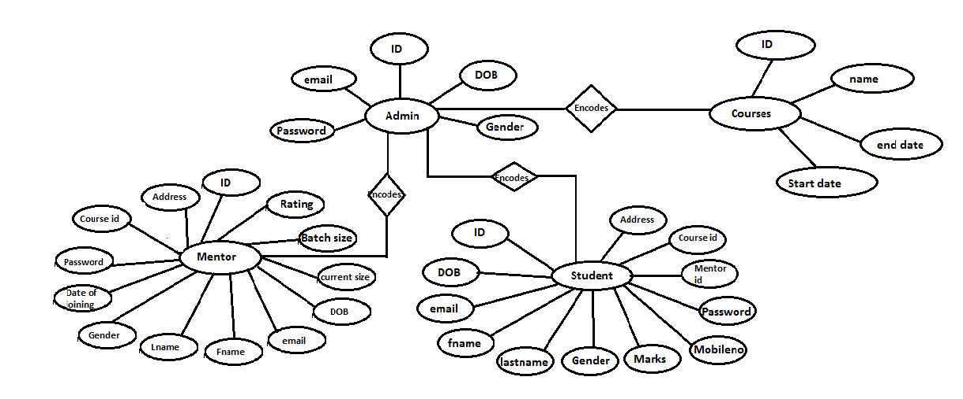
ER Diagram:

Slide 8
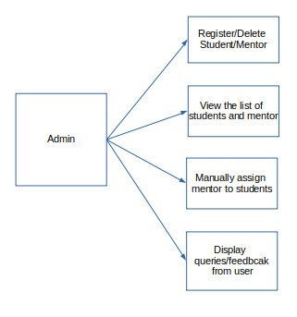
Admin Model:

Slide 9
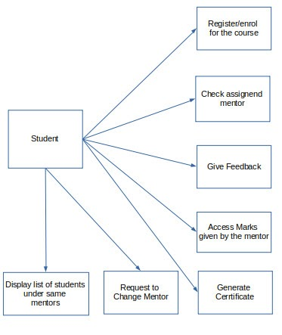
Student Model:

Slide 10
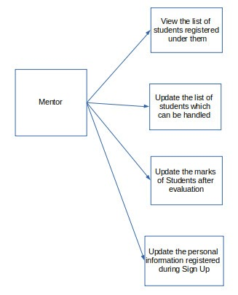
Mentor Model :

Slide 11
Sequence Diagram: Admin Model:

Slide 12
Student Model:

Slide 13
Mentor Model:

Slide 14
Data Flow Diagram: Data Flow Diagram represents a detailed and well-explained diagram of system components.
Level 1 - DFD Mentor Model:

Slide 15
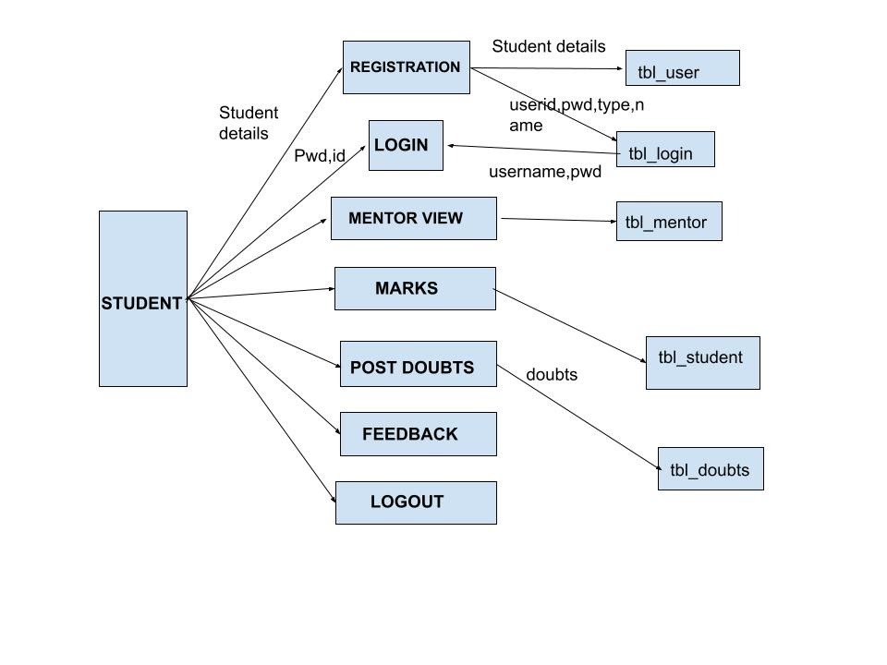
DFD: Data Flow Diagram represent detailed and well explained diagram of system components DFD Student Model:

Slide 16
DFD Admin Model:

Slide 17
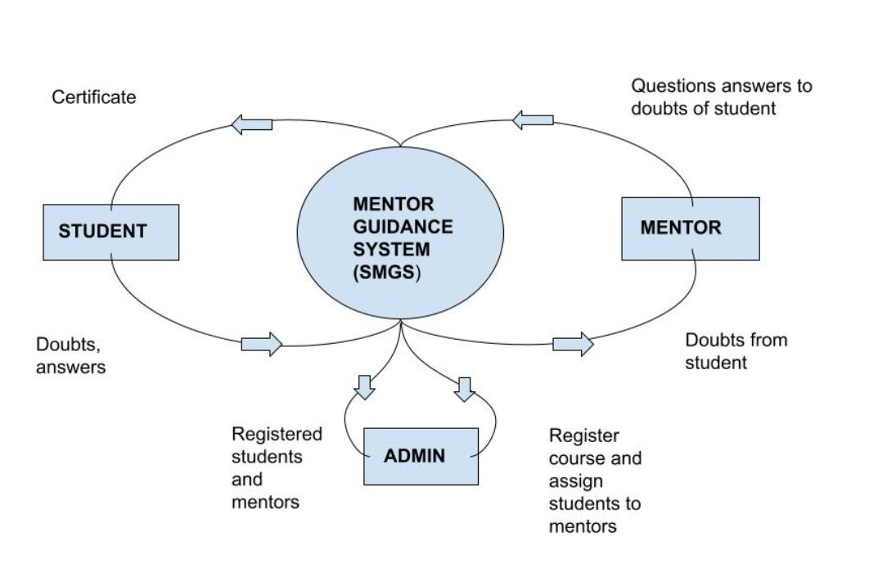
DFD: Data Flow Diagram represent detailed and well explained diagram of system components

Slide 18
Activity Diagram
Admin Activity Diagram

Slide 19
Mentor Activity Diagram

Slide 20
Student Activity Diagram

Slide 21
User Interface :

Slide 22
Login Page :

Slide 23
Student Registration :

Slide 24
Student Home Page :

Slide 25
Mentor Assign:

Slide 26
Mentor Details :

Slide 27
Course Information :

Slide 28
Course Information

Slide 29
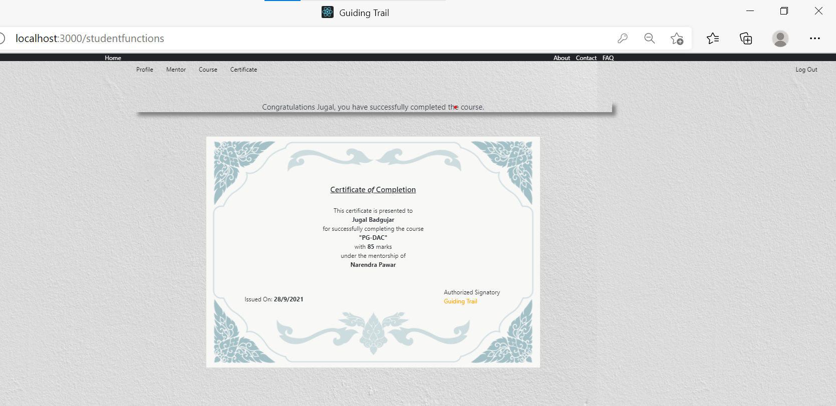
Certificate

Slide 30
Batch Details

Slide 31
Update Students Marks

Slide 32
About Us

Slide 33
Future Scope:
As stated before, this project enhances the communication between student and mentor thereby improving the academic performances of the student. Each student is graded according to their Performances and they receive questions based on these grades. Their grades may improve or fall based on their performances. Hence varying levels of attention can be given to the students. By this work, we conclude that e-mentoring in an academic institute can be developed and tremendous System which is easily accessible to parents as well as mentors and students. Hence it will allow the mentors to dedicate more time whenever they wish and can give much precise feedback that will give proper guidance and the right solution to the problems of students.

Slide 34
Thank You

